Slide 1
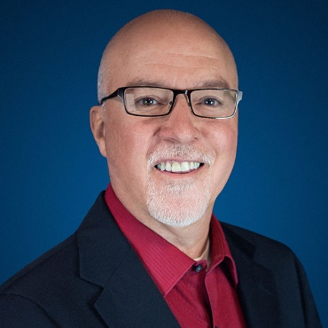

Ignite Conference 2023
PRESENTER
Joseph Padilla
Vice President for Ministry Relations

Slide 2


Notes:
OA Council Theme

Slide 3
HOW WE SERVE
Supporting Alliance Churches Since 1959
Loans
Investments
Stewardship & Generosity
Notes:
When most people think of Orchard Alliance, they think of one or more of these things. Usually based on their experience with us.
INVESTMENTS:
Individuals: Certificates, IRAs, Agreements (Individual, 403(b), Shell Point, and Missionary Retiral)
Organizations: Agreements, Certificates, Institutional Reserve Funds, Ministry Gift Funds
LOANS:
Individuals: Investments that support Self-Funding
Organizations: Church Loans, Ministry Loans, Lines of Credit
GENEROSITY:
Individuals: Will & Estate Planning, Non-Cash Giving, Complex and Tax-Efficient Giving
Organizations: Planned Giving Resources, Generosity and Stewardship Services, Non-Cash Gift Processing

Slide 4
Sibili
Si Ergo
Fortibuses Enero
Nobili Demis Trux
Sewatis Enem
Cowsendux

Slide 5
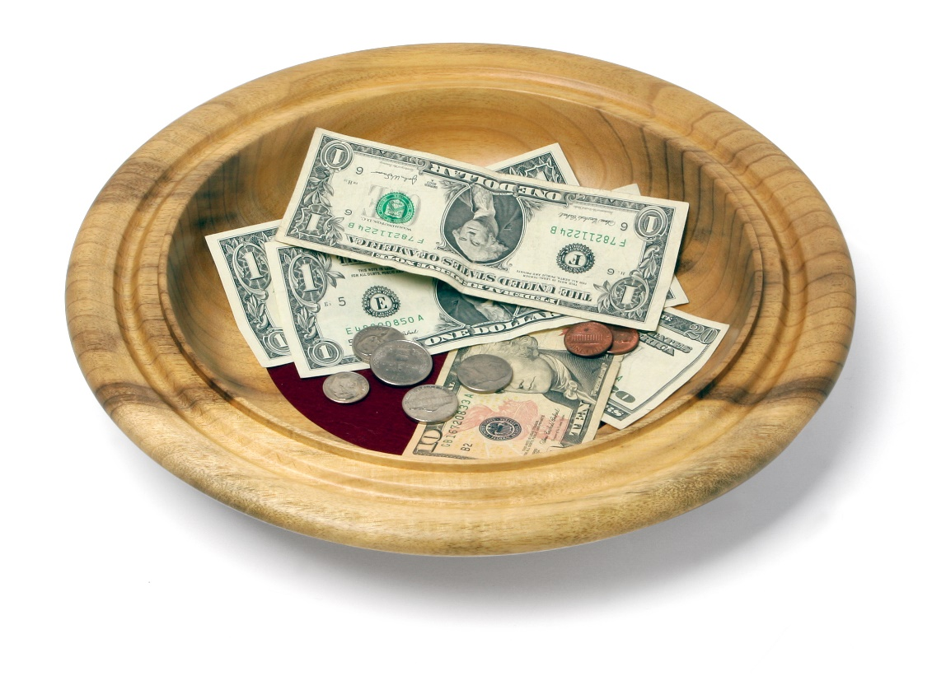

THE WAY PEOPLE GIVE TODAY IS CHANGING!

Slide 6

REALITY IS…
CASH, SAVINGS &
CHECKING ACCOUNTS
10%
Cash
APPRECIATED ASSETS:
Public Stock
Private Stock
Real Estate
Business sale
IRA gifts
Gifts from your will
90%
Non-cash

Slide 7




PLANNED GIVING MICROSITE
Self-contained microsite, customized with your color, images, and church contacts (Orchard Alliance maintains and updates the content)
Easily added to your website
No cost to Alliance churches

Slide 8
Notes:
OA Council Theme

Slide 9


Financial Discipleship Ministry
Where Faith and Finance Meet

Slide 10


To help shape hearts, create trust, and inform minds.
OUR GOAL:
Website
Ron Blue Materials
Notes:
Root for their joy and their life, not their donations
Goal is to communicate that we are a partner
Faith and Finance resource images
Personalized advice
Our goal is to serve you – so you can shape hearts, create trust, and inform minds.

Slide 11

  Scan the code for more information or to request our FREE Financial Discipleship starter pack.
Notes:
Questions Slide

Slide 12
Ignite Conference 2023
PRESENTER
Joseph Padilla
Vice President for Ministry Relations

