Slide 1


Slide 2
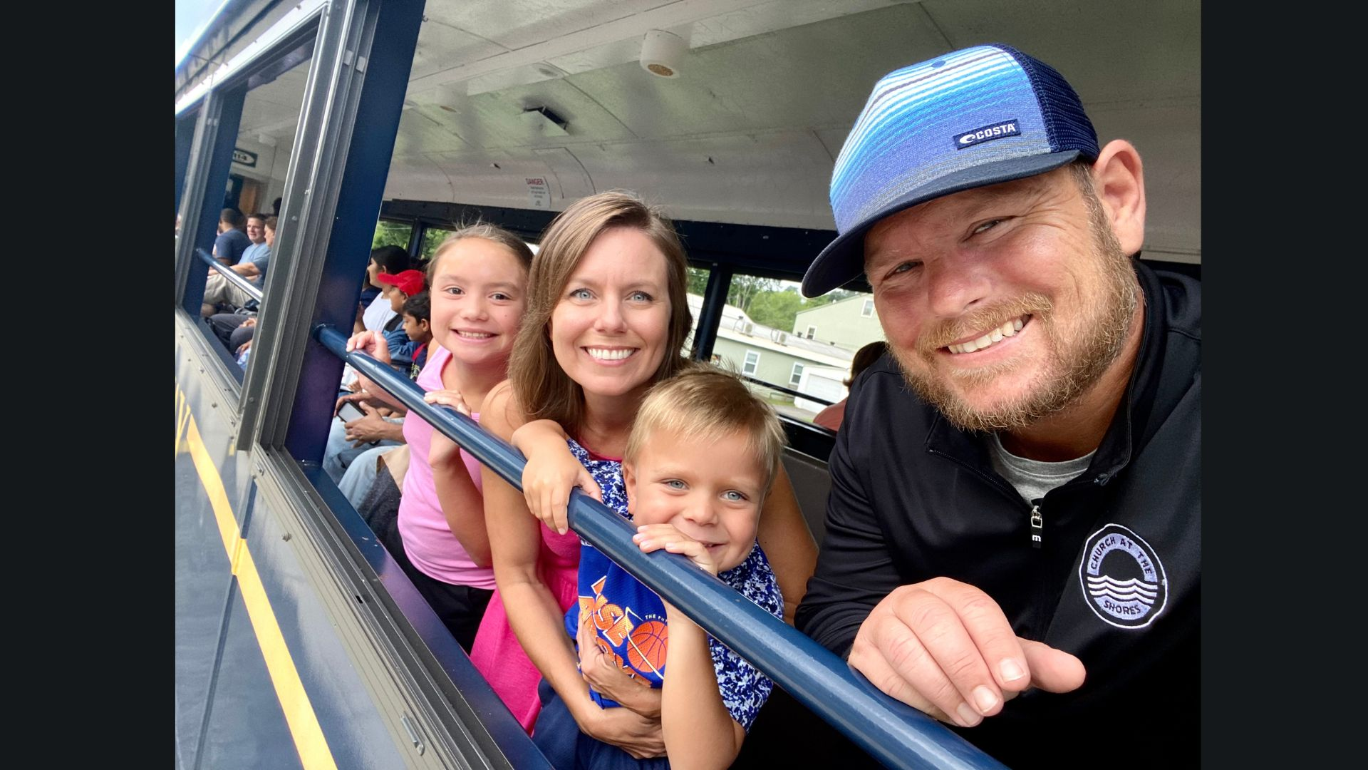

Slide 4
Obey God and leave all the consequences to Him.

Slide 5
The greatest gift you will give to your church is a physically, emotionally, relationally, and spiritually
healthy version of you.

Slide 6
Now when David had served God’s purpose in his own generation, he fell asleep; he was buried with his ancestors and his body decayed.
Acts 13:36

Slide 7
So all the elders of Israel gathered together and came to Samuel at Ramah. They said to him, “You are old, and your sons do not follow your ways; now appoint a king to lead us, such as all the other nations have.”
1 Samuel 8:4-5

Slide 8
“You have done a foolish thing,” Samuel said. “You have not kept the command the Lord your God gave you; if you had, he would have established your kingdom over Israel for all time. But now your kingdom will not endure; the Lord has sought out a man after his own heart and appointed him ruler of his people, because you have not kept the Lord’s command.”
1 Samuel 13:13-14

Slide 9
The Lord said to Samuel, “How long will you mourn for Saul, since I have rejected him as king over Israel?
1 Samuel 16:1

Slide 10
There is a time to grieve and
a time to go forward.

Slide 11
Fill your horn with oil and be on your way; I am sending you to Jesse of Bethlehem. I have chosen one of his sons to be king.”
1 Samuel 16:1

Slide 12
When they arrived, Samuel saw Eliab and thought, “Surely the Lord’s anointed stands here before the Lord.”
1 Samuel 16:6

Slide 13
But the Lord said to Samuel, “Do not consider his appearance or his height, for I have rejected him. The Lord does not look at the things people look at. People look at the outward appearance, but the Lord looks at the heart.”
1 Samuel 16:7

Slide 14
Then Jesse called Abinadab and had him pass in front of Samuel. But Samuel said, “The Lord has not chosen this one either.” Jesse then had Shammah pass by, but Samuel said, “Nor has the Lord chosen this one.” Jesse had seven of his sons pass before Samuel, but Samuel said to him, “The Lord has not chosen these.”
1 Samuel 16:8-10

Slide 15
So he asked Jesse, “Are these all the sons you have?” “There is still the youngest,” Jesse answered. “He is tending the sheep.” Samuel said, “Send for him; we will not sit down until he arrives.”
1 Samuel 16:11

Slide 16
So he sent for him and had him brought in. He was glowing with health and had a fine appearance and handsome features. Then the Lord said, “Rise and anoint him; this is the one.” So Samuel took the horn of oil and anointed him in the presence of his brothers, and from that day on the Spirit of the Lord came powerfully upon David.
1 Samuel 16:12-13

Slide 17
To have a heart for God means that
we pursue the priorities, the purposes and the presence of God.

Slide 18
Be Faithful in Your Field

Slide 19
Be Faithful When
You Have Been Forgotten

Slide 20
Be Faithful As You Wait
For Your Future

Slide 21
Am I giving myself to intentional times of prayer?
Am I honoring the sabbath?
Am I committed to interior examination?
Am I honest with others?
Am I joining my life to the poor and marginalized?
Am I growing in loving God and loving others?
Am I growing in a joyful understanding of the gospel?

